Slide 1

E.A. TECHNIQUE (M) BERHAD
23rd Annual General Meeting
17 May 2017

Slide 2
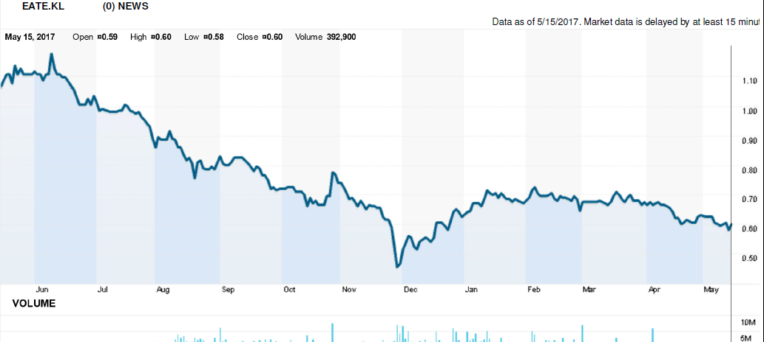
Corporate Overview
Incorporated on 18 January 1993 as a private limited company as E.A. Technique (M) Sdn Bhd.
Secured Petronas license in 1995.
Dato’ Hak appointed Managing Director in 2002
Kulim (M) Berhad holds a 50.6% equity via Sindora Berhad and has been a shareholder since Dec 2006.
Listed on Bursa Malaysia Main Board on 11 December 2014

Slide 3
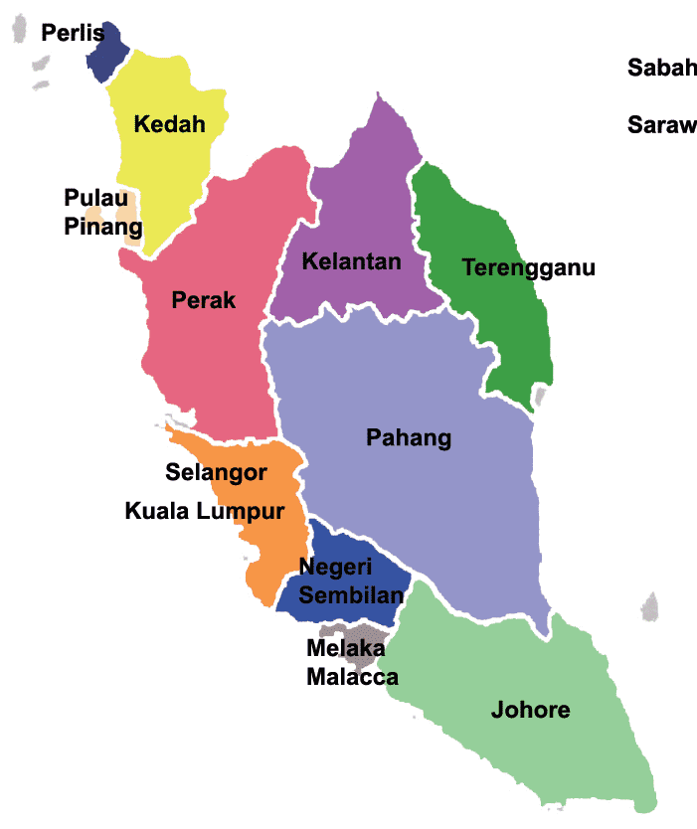
Our Office / Operation Locations
NO | OFFICE | LOCATION
1 | HEADQUARTERS | UNIT C-3A-3A, SETIAWANGSA BUSINESS SUITE, KUALA LUMPUR
2 | PROJECT OFFICE | UNIT B-1-1, SETIAWANGSA BUSINESS SUITE, KUALA LUMPUR
3 | BRANCH OFFICE | NORTHPORT, PELABUHAN KLANG
4 | BRANCH OFFICE | SG. UDANG PORT, MELAKA
5 | BRANCH OFFICE | KERTIH PORT, TERENGGANU
6 | SITE PROJECT OFFICE | PASIR GUDANG, JOHOR
7 | JOHOR SHIPYARD & ENGINEERING SDN. BHD. | HUTAN MELINTANG, PERAK
7
5
3
2
1
4
6

Slide 4
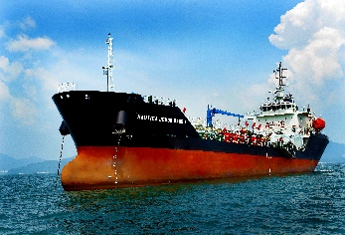
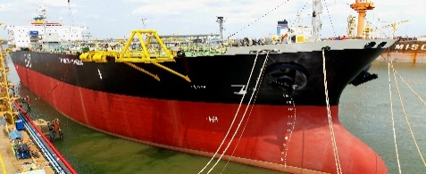
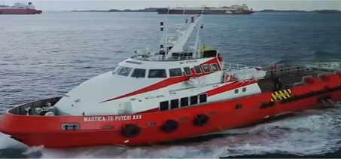
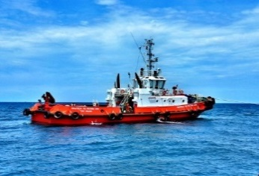
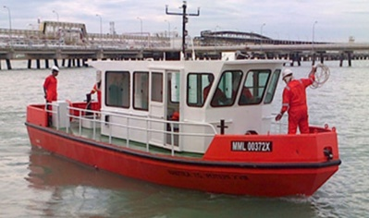
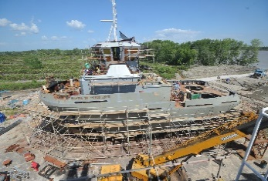
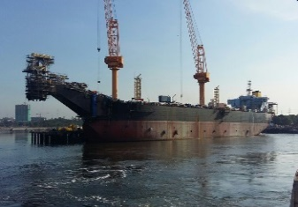
Marine Services Specialist
Marine Transportation & Offshore Storage of O&G
- Product Tanker
- FSU/FSO
- OSV
Product Tankers
FSU/FSO
OSV
Port Marine Services
- Tugboats
- Mooring boats
Tugboats
Mooring Boats
Marine Engineering
- EPCIC
- Shipbuilding
- Ship repair
Johor Shipyard
EPCIC

Slide 5

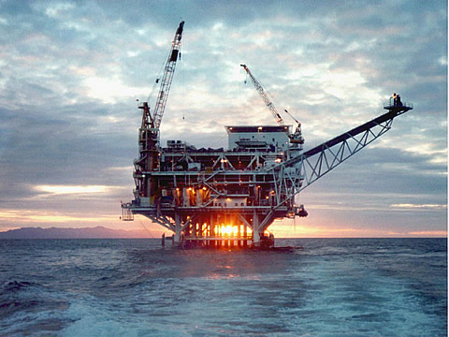






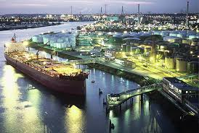




Oil & Gas Value Chain
Where is EA Technique?
Upstream
Exploration
Field and production operations
Offshore storage
Midstream
Transportation
Processing
Storage and distribution
Downstream
Refining & petro chemical products
Wholesale & marketing operations

Slide 6
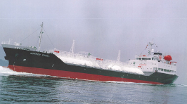
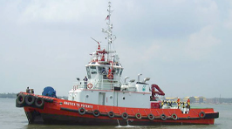
Marine Vessel Fleet
Third-party Vessels
At present, E.A. Technique operates a total fleet of 40 marine vessels, which are illustrated as below:
2 LPG Tankers
2 Tugboats
Marine Transportation and Offshore Storage of O&G
Product Tanker
Floating Storage Unit
Fast Crew Boat
Provision of
Port Marine Services
Tugboats
Mooring Boats

Slide 7
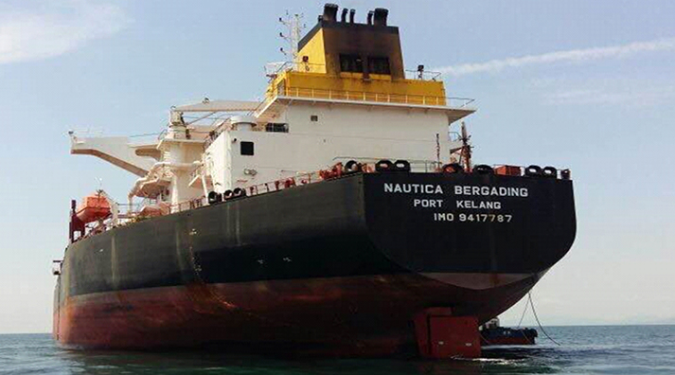
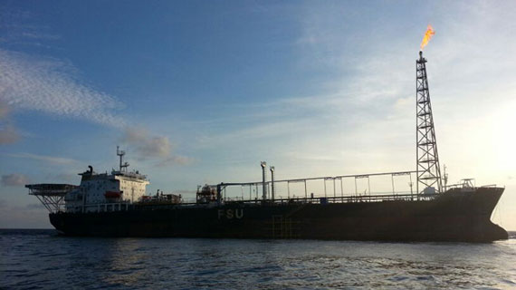
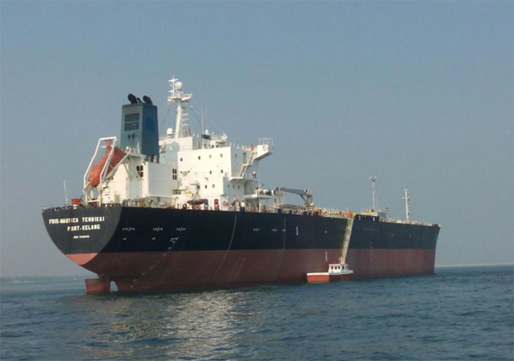
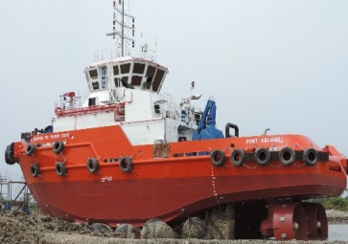
Project Briefs
HESS (North Malay Basin)
US$191.8mil (about RMRM831.74 mil*) EPCIC contract to provide a floating storage and offloading (FSO) facility to be delivered 1Q2017 ; project started in 1Q2015
Another 5% of the contract value recognised upon hook up and commissioning
and the balance 10% over the next 24 months the warranty period).
Kayu Manis Oilfield, Anjung Kecil Oilfield, Bintulu
MT Nautica Muar has been laid up since October 2016 and currently undergoing refurbishment for a period of 6 months.
A new long term contract with an expected start date
of April 2017 for deployment at a field which is to be identified.
Tembikai RSC, Terengganu
MT Tembikai contract tenure 4 + 1 year.
FLNG1 (Kanowit field)
FLNG1; 4 harbour tugs for 72 months
4 harbor tugs have been delivered to FLNG1 which is scheduled to commence operation by mid 2017
*Note: the rate used as at 15th May 2017 @ 4.3365

Slide 8
Vessel Utilisation
Type of Vessel ⁽¹⁾ | Utilisation Rate For FYE 31st December 2016 | Utilisation Rate For As at 31st March 2017
Product Tankers | 92% | 93%
FSU | 100% | 100%
Fast Crew Boats | 100% | 100%
Harbour Tugboats | 99% | 99%
Utility Tugboats | 100% | 100%
Mooring Boats | 91% | 84%

Slide 9
Financial Highlights

Slide 10
Going Forward
Sustainability of earnings
Recurring revenues with balance mix of long term and midterm charters. Projects spread from i) port operations to ii) transportation of finished products and to iii) brownfields (ie production fields and not exploration related)
New Business coming in / Bid Book
Existing order book of RM1.7 billion strengthen by contracts secured commencing in 2015/16 with upside from bid book in excess of RM1 billion.
GLC shareholder and strong Balance Sheet
Johor Corp (thru Kulim Bhd) is a 51% shareholder. Gearing levels manageable at 1.6x with matching long term debt and longer charter tenures. US$ debt similarly naturally hedged with US$ lease charters.

Slide 11
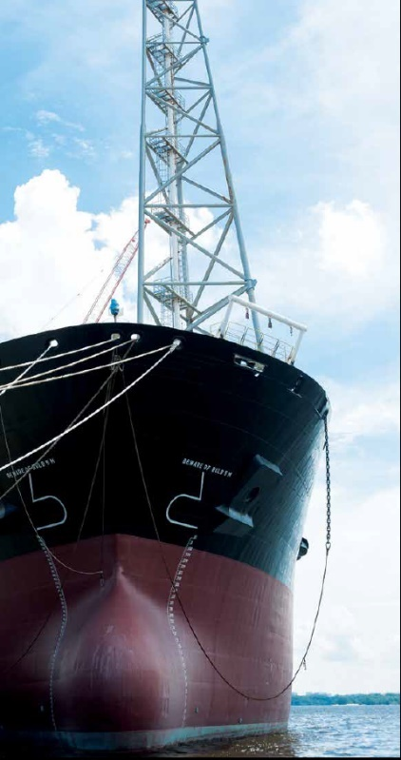
THANK YOU
Questions ?
DATO’ IR. ABDUL HAK BIN MD. AMIN
Address
Setiawangsa Business Suites
Unit C-3A-3A, No.2 Jalan Setiawangsa 11,
Taman Setiawangsa, 54200 Kuala Lumpur,
Malaysia.
Contact
Tel : 03 4252 5422
Fax : 03 4252 2163 / 03 4251 2985
Email : eat@Eatechnique.com.my

