Slide 1
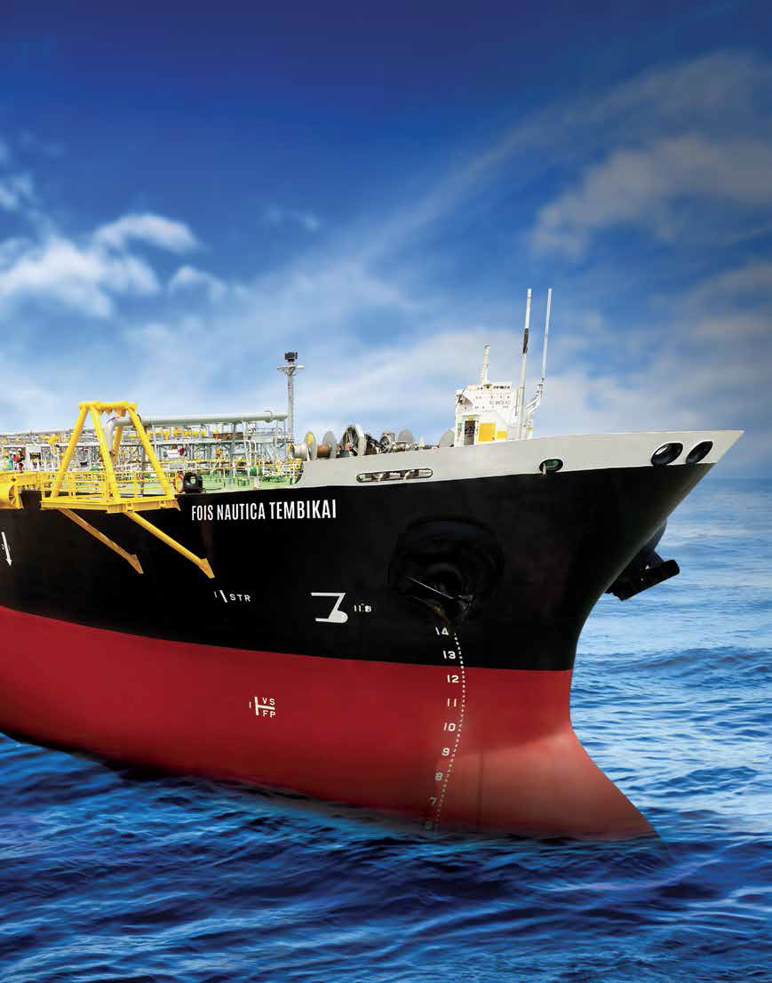
E.A. TECHNIQUE (M) BERHAD
25TH ANNUAL GENERAL MEETING
29 APRIL 2019

Slide 2
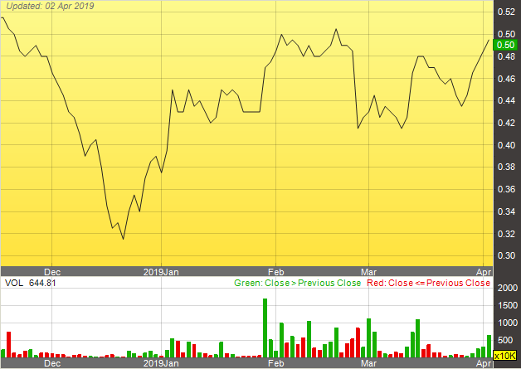
CORPORATE OVERVIEW
Incorporated on 18 January 1993 as a private limited company as E.A. Technique (M) Sdn Bhd.
Secured PETRONAS license in 1995.
Dato’ Hak appointed Managing Director in 2002
.
Kulim (M) Berhad (100% JCorp Group) holds a 53.16% equity through subsidiary company, Sindora Berhad and has been a shareholder since December 2006.
Other main shareholders are Dato’ Abdul Hak bin Md Amin and Datin Hamidah binti Omar, which hold a total of 21.47% equity.
Listed on Bursa Malaysia Main Board on 11 December 2014 (EATECH 5259).
SHARE STATISTIC | RM
Market Capitalisation (million) | 252
Share Price (26 April 2019) | 0.50
Par Value | 0.25
NTA per share (as at Dec 2018) | 0.45
Share Price upon Listing (2014) | 0.65
Highest Share Price (2015) | 1.50

Slide 3
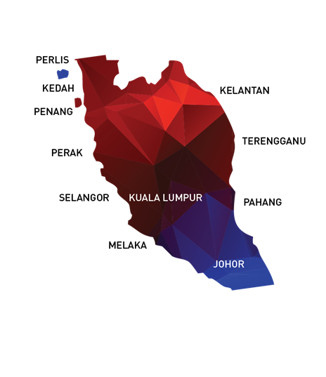
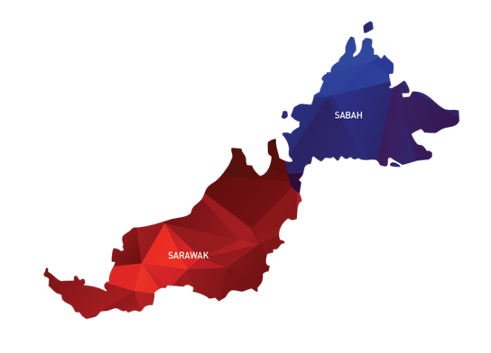
OUR OFFICES / OPERATION LOCATIONS
NO | OFFICE | LOCATION
1 | HEADQUARTERS | UNIT C-3A-3A, SETIAWANGSA BUSINESS SUITE, KUALA LUMPUR
2 | SITE OFFICE | NORTHPORT, PELABUHAN KLANG
3 | SITE OFFICE | KERTIH PORT, TERENGGANU
4 | SITE OFFICE | BINTULU PORT, SARAWAK
5 | SITE OFFICE | SG. UDANG PORT, MELAKA
6 | JOHOR SHIPYARD & ENGINEERING SDN. BHD. | HUTAN MELINTANG, PERAK
7 | LIBRA PERFEX PRECISION SDN BHD | MIRI, SARAWAK

Slide 4
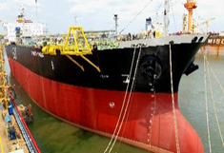
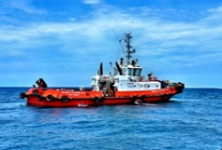
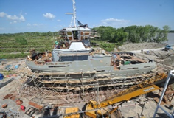
BUSINESS OVERVIEW
Marine Operations
Non – Marine Operations
Marine Transportation and Offshore Storage
of Oil and Gas
Port Marine Services
Marine Engineering Services
Charter hire of :
Products Tankers
Floating Storage Unit (“FSU”) / Floating Storage Operation (“FSO”)
Crew Boats
Towage Service
Mooring Service
Dockside Mooring Service
Shipping and Ship repair

Slide 5

MARINE VESSEL FLEET
E.A. Technique operates a total fleet of 42 marine vessels, and 2 charter in vessels
MARINE TRANSPORTATION AND OFFSHORE STORAGE OF OIL & GAS
PORT MARINE SERVICES
OIL TANKERS
MT NAUTICA JOHOR BAHRU
MT NAUTICA MAHARANI
MT NAUTICA BATU PAHAT
MT NAUTICA KOTA TINGGI
MT NAUTICA RENGGAM
MT NAUTICA PAGOH
CREW BOATS
MV NAUTICA TG PUTERI IV
MV NAUTICA TG PUTERI XXX
MV NAUTICA GAMBIR
MV NAUTICA LANGSAT
PORT SERVICES
MV NAUTICA TG PUTERI I | MV NAUTICA TG PUTERI XIX
MV NAUTICA TG PUTERI II | MV NAUTICA TG PUTERI XX
MV NAUTICA TG PUTERI IX | MV NAUTICA TG PUTERI XXI
MV NAUTICA TG PUTERI X | MV NAUTICA TG PUTERI XXII
MV NAUTICA TG PUTERI XI | MV NAUTICA TG PUTERI XXIV
MV NAUTICA TG PUTERI XII | MV NAUTICA TG PUTERI XXV
MV NAUTICA TG PUTERI XV | MV NAUTICA TG PUTERI XXVI
MV NAUTICA TG PUTERI XVI | MV NAUTICA TG PUTERI XXXIII
MV NAUTICA TG PUTERI XVII | MV NAUTICA TG PUTERI XXXIV
MV NAUTICA TG PUTERI XVIII
FLOATING STORAGE OFFLOADING
FSU NAUTICA MUAR
MT FOIS NAUTICA TEMBIKAI
THIRD PARTY VESSEL
KEJORA 59
KEJORA 57
CONSTRUCTION/MAINTENANCE
MV NAUTICA AIR HITAM
MV NAUTICA TG PUTERI XXXV
MV NAUTICA TG PUTERI XXXVI
AMAL II
MV NAUTICA TG PUTERI XXXVII
MV NAUTICA TG PUTERI VII
MV NAUTICA TG PUTERI VIII
PFLNG 1
MV NAUTICA TG PUTERI XXIII
MV NAUTICA TG PUTERI XXVII
MV NAUTICA TG PUTERI XXVIII
MV NAUTICA TG PUTERI XXIX

Slide 6
VESSEL UTILISATION
TYPE OF VESSEL ⁽¹⁾ | UTILISATION RATE FOR FYE 2017⁽²⁾ | UTILISATION RATE FOR FYE 2018⁽²⁾
PRODUCT TANKERS | 73% | 76%
FSU | 100% | 100%
FAST CREW BOATS | 59% | 83%
PFLNG1 | 100% | 100%
PORT SERVICES | 84% | 88%
AVERAGE UTILISATION RATE | 80% | 88%
Notes: (1) Own marine vessels only (2) Utilisation rate is computed based on the number of days contracted divided by 365 days

Slide 7
2018 OPERATIONAL PERFORMANCE
Marine Operations
Non – Marine Operations
Marine Transportation and Offshore Storage
of Oil and Gas
Port Marine Services
Marine Engineering Services
Charter hire of :
Products Tankers
Floating Storage Unit (“FSU”) / Floating Storage Operation (“FSO”)
Crew Boats
Shipping and Ship repair
Towage Service
Mooring Service
Dockside Mooring Service
CHARTER HIRE
+24.4%
Revenue grew to RM278.3 million
EPCIC
-1.8%
Revenue declined to RM140.7 million

Slide 8
2018 OPERATIONAL HIGHLIGHTS
2018 was a turnaround year whereby the group retuned back to the black and recorded a profit before tax of RM90.4 million
Underlying core marine operations (tankers, FSO, OSV and port) remains robust and underpinned by long term charters. Operationally, this core operations revenue grew in 2018.
New contract awards and contract renewals in 2018 is inline with the general recovery for the O&G industry and is expected to improve further in 2019 and beyond.

Slide 9
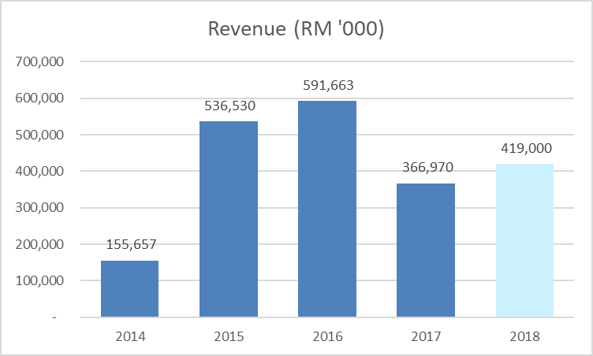
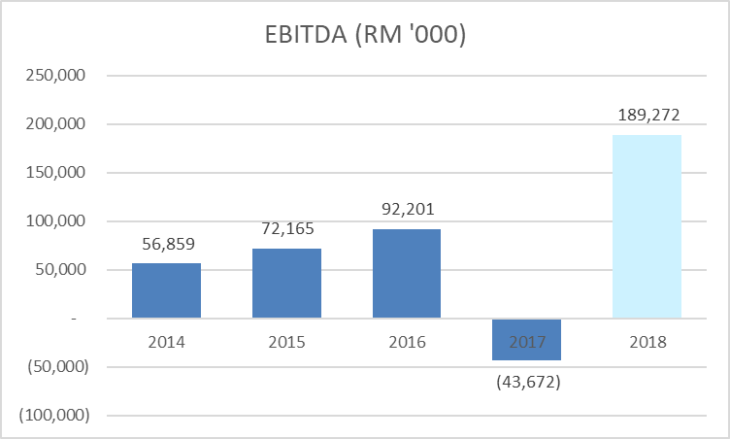
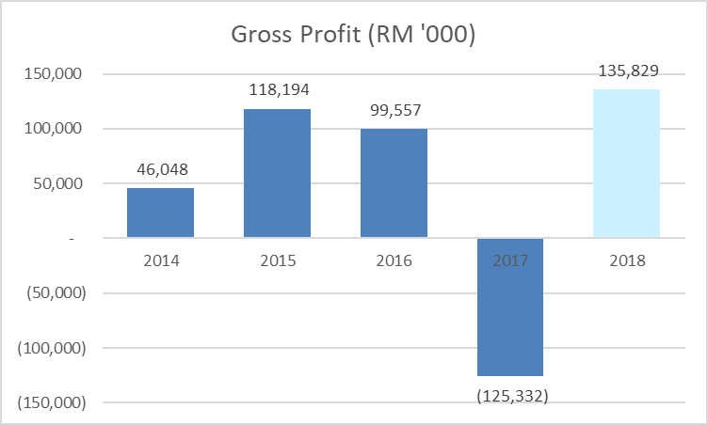
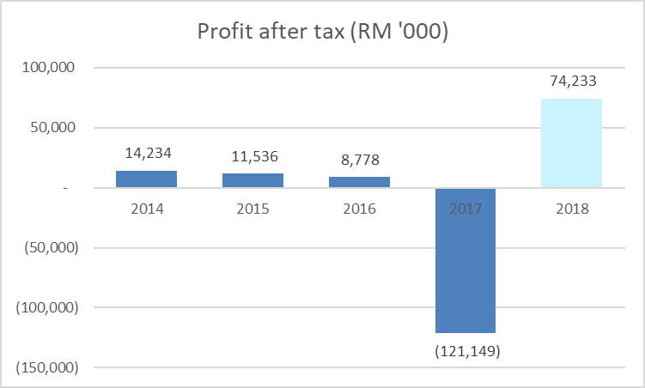
FINANCIAL HIGHLIGHTS – FY2018

Slide 10
SUMMARY – GOING FORWARD
FOCUS ON GROWING CORE REVENUES AND PROFITABILITY
Successfully handover the EPCIC project in the first half of 2018 and thereafter to return to our core competencies of marine operations, focusing on securing more charters in both the Oil & Gas as well as port operation segments.
FOCUS ON CORE COMPETENCIES
The group will seek to improve operational efficiency through aggressive cost management and enhance efficiency in our existing marine operations. The group’s existing order book as at end 2018 stands at RM572.49 million with an extension period worth an additional RM216.64 million.
FOCUS ON FISCAL DICIPLINE AND FINANCIAL RESILIENCE
The group remain committed to strengthening our balance sheet to further enhance the group’s financial health in order to steer the group back onto the growth path.

Slide 11
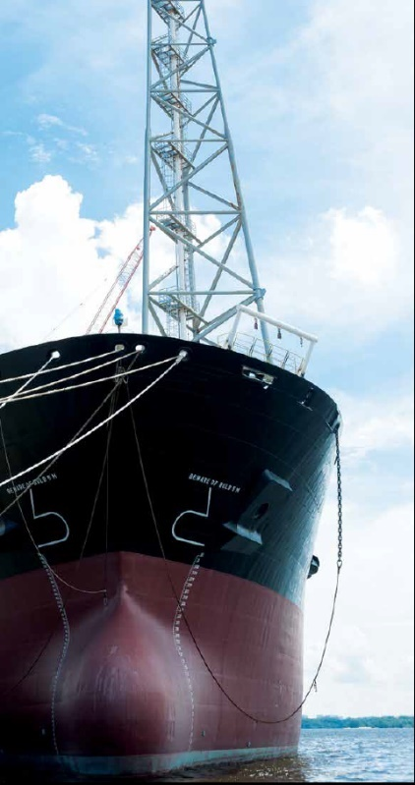
THANK YOU
Questions ?
DATO’ IR. ABDUL HAK BIN MD. AMIN
Address
Setiawangsa Business Suites
Unit C-3A-3A, No.2 Jalan Setiawangsa 11,
Taman Setiawangsa,
54200 Kuala Lumpur, Malaysia.
Contact
Tel : 03 4252 5422
Fax : 03 4252 2163 / 03 4251 2985
Email : eat@eatechnique.com.my

