Slide 1
E.A. TECHNIQUE (M) BERHAD
26TH ANNUAL GENERAL MEETING
15 JULY 2020

Slide 2
Corporate Overview
Share Statistics
Market Capitalization (RM million) | 190.98
Share Price (RM) @ 14 July 2020 | 0.36
Shares Outstanding (million) | 530.5
52 Week High (RM) | 0.48
52 Week Low (RM) | 0.20
1993
Incorporated as E.A. Technique (M) Sdn Bhd
1995
Secured PETRONAS license
1997
First contract with PETRONAS Dagangan
2006
JCorp Group (through Sindora Berhad) acquires 51% equity (still majority shareholder)
2014
Listed on Bursa Malaysia Main Board (EATECH 5259)
2020
Operating 48 vessels
2016
2017
2018
2019
2020

Slide 3
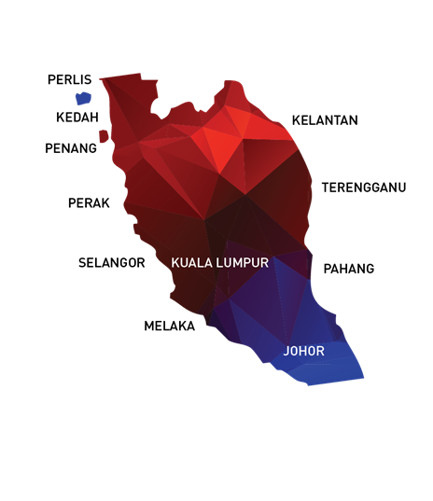
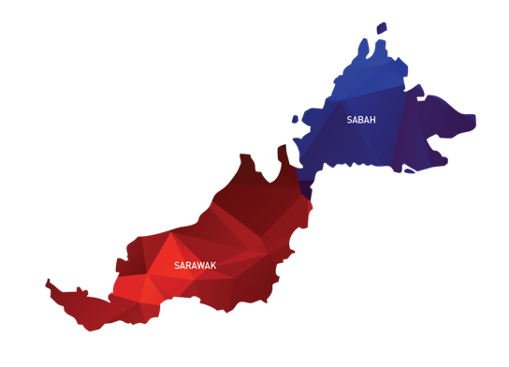
Our Offices / Operation Locations
NO | OFFICE | LOCATION
1 | HEADQUARTERS | UNIT C-3A-3A, SETIAWANGSA BUSINESS SUITE, KUALA LUMPUR
2 | PROJECT OFFICE | UNIT B-1-1, SETIAWANGSA BUSINESS SUITE, KUALA LUMPUR
3 | SITE OFFICE | NORTHPORT, PELABUHAN KLANG
4 | SITE OFFICE | KERTIH PORT, TERENGGANU
5 | SITE OFFICE | BINTULU PORT, SARAWAK
6 | SITE OFFICE | SG. UDANG PORT, MELAKA
7 | JOHOR SHIPYARD & ENGINEERING SDN. BHD. | HUTAN MELINTANG, PERAK
8 | LIBRA PERFEX PRECISION SDN BHD | BINTULU PORT, SARAWAK

Slide 4
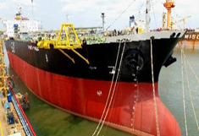
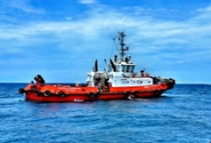
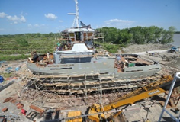
Business Overview
Marine Operations
Non – Marine Operations
Marine Transportation and Offshore Storage
of Oil and Gas
Port Marine Services
Marine Engineering Services
Charter hire of :
Products Tankers
Floating Storage Unit (“FSU”) / Floating Storage Operation (“FSO”)
Crew Boats
Towage Service
Mooring Service
Dockside Mooring Service
Ship building and repair

Slide 5
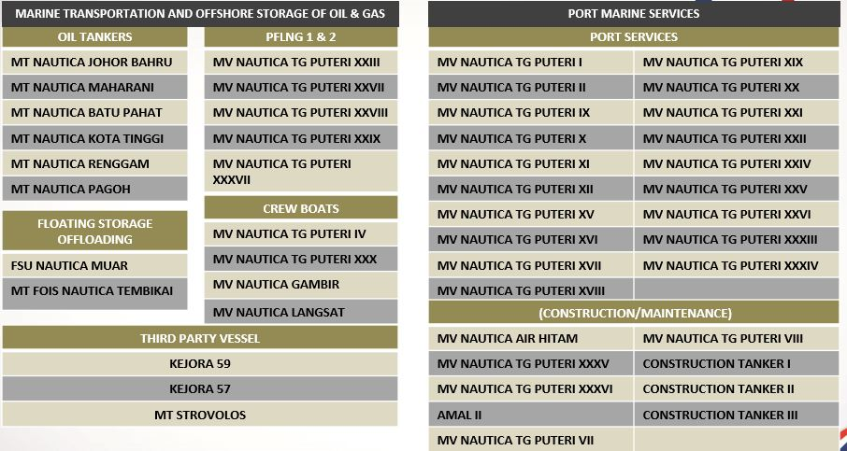

Marine Vessel Fleet
E.A. Technique operates a total fleet of 45 marine vessels, and 3 charter in vessels

Slide 6
Vessel Utilisation
TYPE OF VESSEL | UTILISATION RATE 2019 | UTILISATION RATE 2018
Product Tankers | 81.18% | 76.00%
FSU/FSO | 100.00% | 100.00%
Crew Boats | 54.19% | 83.00%
PFLNG 1 | 56.20% | 55.14%
Port Services | 90.83% | 90.00%
Average Utilisation Rate | 81.55% | 82.80%

Slide 7
2019 Operational Performance
Marine Operations
Non – Marine Operations
Marine Transportation and Offshore Storage
of Oil and Gas
Port Marine Services
Marine Engineering Services
Charter hire of :
Products Tankers
Floating Storage Unit (“FSU”) / Floating Storage Operation (“FSO”)
Crew Boats
Towage Service
Mooring Service
Dockside Mooring Service
Ship building and repair
CHARTER HIRE
-0.78%
Slight drop in revenue to RM177.6 million
SERVICES
-4.47%
Slight revenue drop of RM4.4 million
EPCIC
-99.66%
No EPCIC revenue for FY19

Slide 8
2019 Operational Highlights
Building on the turnaround of 2018, the group recorded a revenue of RM272 million and profits before tax of RM33 million.
Underlying core marine operations (tankers, FSO, OSV and port) remains robust and underpinned by long term charters. Continued high utilization rates of above 80% on average for all vessels.
Finalization of EPCIC project in 2018 is the main cause of drop in revenue, hence most of the revenue was contributed by core business of charter hire.
Borrowings and gearing continue to decrease to RM333 million and 1.18 respectively.

Slide 9
Financial Highlights – FY2019

Slide 10
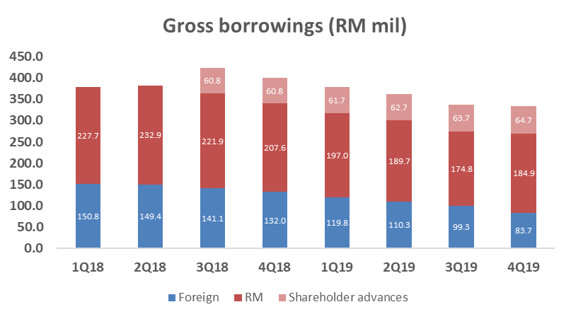
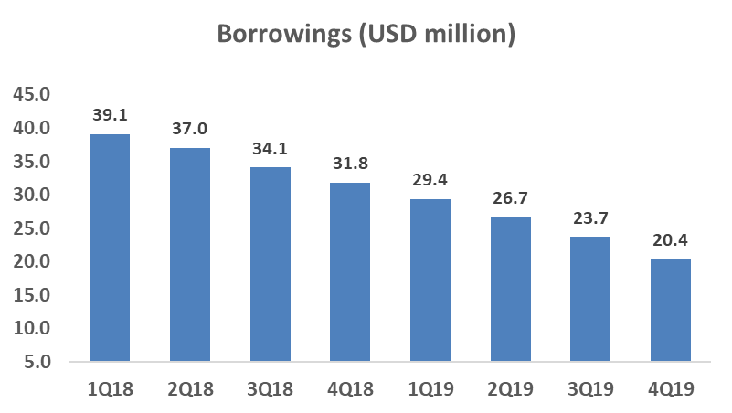
Financial Highlights – FY2019
Downtrend of gross borrowings (both RM and USD) shows management’s good track record in managing debts and repayment.

Slide 11
SUMMARY - Going Forward
Focus on growing core revenues and profitability
EPCIC project has been completed and the group now returns to our core competencies of marine operations but focusing on securing more charters in both the Oil & Gas as well as port operation segments.
Focus on core competencies
The group will seek to improve operational efficiency through aggressive cost management and enhance efficiency in our existing marine operations. Our order book as of the end of 2019 is approximately RM1.165 billion, including options, and we remain alert to tendering for new contracts.
Focus on fiscal discipline and financial resilience
The group remain committed to strengthening our balance sheet to further enhance the group’s financial health while also growing our customer base. Fleet expansions will be based on contracts secured with a view to achieve long-term sustainable value creation.

Slide 12
DATO’ IR. ABDUL HAK BIN MD. AMIN
Address
Setiawangsa Business Suites Unit C-3A-3A, No.2 Jalan Setiawangsa 11, Taman Setiawangsa, 54200 Kuala Lumpur, Malaysia.
Contact
Tel : 03 4252 5422
Fax : 03 4252 2163 / 03 4251 2985
Email : eat@eatechnique.com.my
THANK YOU

